Slide 1
Mobile TCP

Slide 2
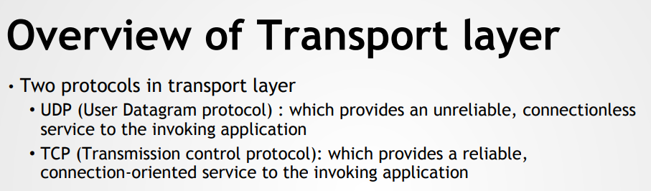
TCP
It has built in mechanism to behave in a network friendly manner
Eg: If TCP finds a packet loss it assumes network internal congestion and slow down the transmission rate
UDP
It does not behave in a network friendly manner
Eg: It continuously keeps sending packets into an already congested network.

Slide 3
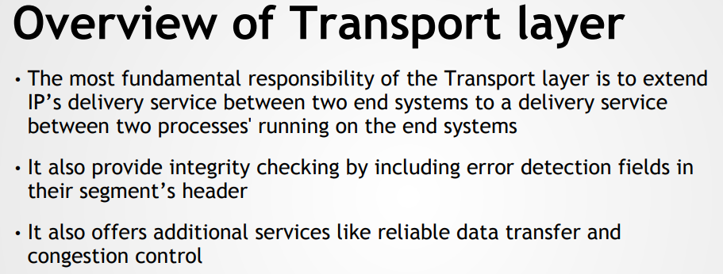

Slide 4
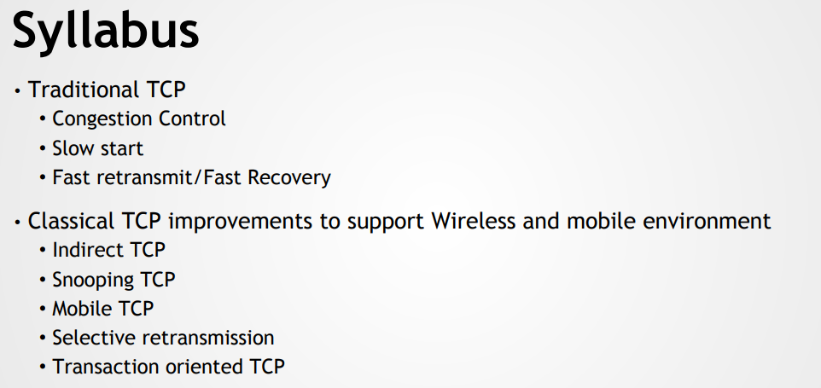

Slide 5
Traditional TCP
Transmission Control Protocol (TCP) is the transport layer protocol that serves as an interface between client and server.
The TCP/IP protocol is used to transfer the data packets between transport layer and network layer.
Transport protocol is mainly designed for fixed end systems and fixed, wired networks.
In simple terms, the traditional TCP is defined as a wired network while classical TCP uses wireless approach.
Mainly TCP is designed for fixed networks and fixed, wired networks

Slide 6
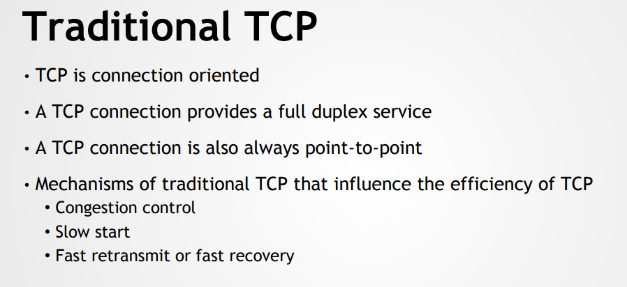

Slide 7
1. Congestion control: During data transmission from sender to receiver, sometimes the data packet may be lost.
It is not because of hardware or software problem.
Whenever the packet loss is confirmed, the probable reason might be the temporary overload at some point in the transmission path. This temporary overload is otherwise called as Congestion.
Congestion is caused often even when the network is designed perfectly.
The transmission speed of receiver may not be equal to the transmission speed of the sender.
If the capacity of the sender is more than the capacity of output link, then the packet buffer of a router is filled and the router cannot forward the packets fast enough.
The only thing the router can do in this situation is to drop some packets.

Slide 8
Congestion control
The receiver sense the packet loss but does not send message regarding packet loss to the sender.
Instead, the receiver starts to send acknowledgement for all the received packets and the sender soon identifies the missing acknowledgement.
The sender now notices that a packet is lost and slows down the transmission process.
By this, the congestion is reduced. This feature of TCP is one of the reason for its demand even today.

Slide 9
2. Slow start: The behavior TCP shows after the detection of congestion is called as slow start.
The sender always calculates a congestion window for a receiver.
At first the sender sends a packet and waits for the acknowledgement.
Once the acknowledgement is back it doubles the packet size and sends two packets.
After receiving two acknowledgements, one for each packet, the sender again doubles the packet size and this process continues. This is called Exponential growth.

Slide 10
Slow start:
It is dangerous to double the congestion window each time because the steps might become too large.
The exponential growth stops at congestion threshold.
As it reaches congestion threshold, the increase in transmission rate becomes linear (i.e., the increase is only by 1).
Linear increase continues until the sender notices gap between the acknowledgments.
In this case, the sender sets the size of congestion window to half of its congestion threshold and the process continues.

Slide 11
Fast re-transmission: In TCP, two things lead to a reduction of the congestion threshold.
One of those is sender receiving continuous acknowledgements for the single packet.
By this it can convey either of two things. One such thing is that the receiver received all the packets up to the acknowledged one and the other thing is the gap is due to packet loss. Now the sender immediately re-transmit the missing packet before the given time expires. This is called as Fast re-transmission.

Slide 12
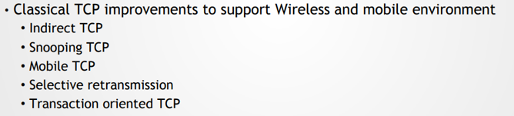

Slide 13
Indirect TCP (I-TCP)
Indirect TCP or I-TCP segments the connection
no changes to the TCP protocol for hosts connected to the wired Internet, millions of computers use (variants of) this protocol
optimized TCP protocol for mobile hosts
splitting of the TCP connection at, e.g., the foreign agent into 2 TCP connections, no real end-to-end connection any longer
hosts in the fixed part of the net do not notice the characteristics of the wireless part

Slide 14
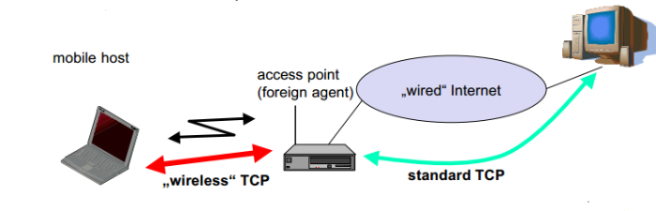
Packet delivery ( CN to MN)
If CN sends packet, FA acknowledges packet and forwards packet to MN
If MN receives packet,it acknowledges
This acknowledgement only used by CN
Similarly if MN sends packet, FA acknowledges packet and forwards it to CN

Slide 15
Snooping TCP
“Transparent” extension of TCP within the foreign agent
buffering of packets sent to the mobile host
lost packets on the wireless link (both directions!) will be retransmitted immediately by the mobile host or foreign agent, respectively (so called “local” retransmission)
the foreign agent therefore “snoops” the packet flow and recognizes acknowledgements in both directions, it also filters ACKs
changes of TCP only within the foreign agent

Slide 16
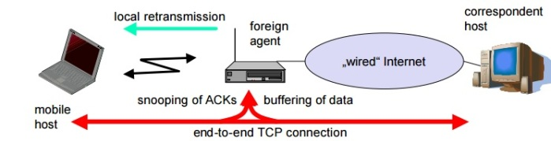
Data transfer to the mobile host
FA buffers data until it receives ACK of the MH, FA detects packet loss via duplicated ACKs or time-out
fast retransmission possible, transparent for the fixed network
Data transfer from the mobile host
FA detects packet loss on the wireless link via sequence numbers, FA answers directly with a NACK to the MH
MH can now retransmit data with only a very short delay

Slide 17
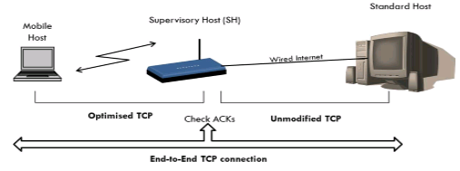
Mobile TCP
The M-TCP splits up the connection into two parts:
An unmodified TCP is used on the Standard host-Supervisory Host section
An optimised TCP is used on the Supervisory Host- Mobile Host section.
The Supervisory Host (SH) adorns the same role as the proxy (Foreign Agent) in I-TCP.
The SH is responsible for exchanging data to both the Standard host and the Mobile host.
Here in this approach, we assume that the error bit rate is less as compared to other wireless links.
So if any packet is lost, the retransmission has to occur from the original sender and not by the SH.
The SH monitors the ACKs (ACK means acknowledgement) being sent by the MH. If for a long period ACKs have not been received, then the SH assumes that the MH has been disconnected (maybe due to failure or moved out of range, etc...).
If so the SH chokes the sender by setting its window size to 0.
Because of this the sender goes into persistent mode i.e. the sender’s state will not change no matter how long the receiver is disconnected.
This means that the sender will not try to retransmit the data.
Now when the SH detects a connectivity established again with the MH (the old SH or new SH if handover), the window of the sender is restored to original value.

Slide 18
Selective retransmission
A very useful extension of TCP is the use of selective retransmission.
TCP acknowledgements are cumulative, i.e., they acknowledge in-order receipt of packets up to a certain packet.
A single acknowledgement confirms reception of all packets up to a certain packet.
If a single packet is lost, the sender has to retransmit everything starting from the lost packet (go-back-n retransmission).
This obviously wastes bandwidth, not just in the case of a mobile network, but for any network.

Slide 19
Selective retransmission
Using selective retransmission, TCP can indirectly request a selective retransmission of packets.
The receiver can acknowledge single packets
The sender can now determine precisely which packet is needed and can retransmit it.

Slide 20
Advantage
a sender retransmits only the lost packets.
This lowers bandwidth requirements and is extremely helpful in slow wireless links.
Disadvantage is that more complex software on the receiver side is needed.
Also more buffer space is needed to resequence data and to wait for gaps to be filled.

Slide 21
